Slide 1
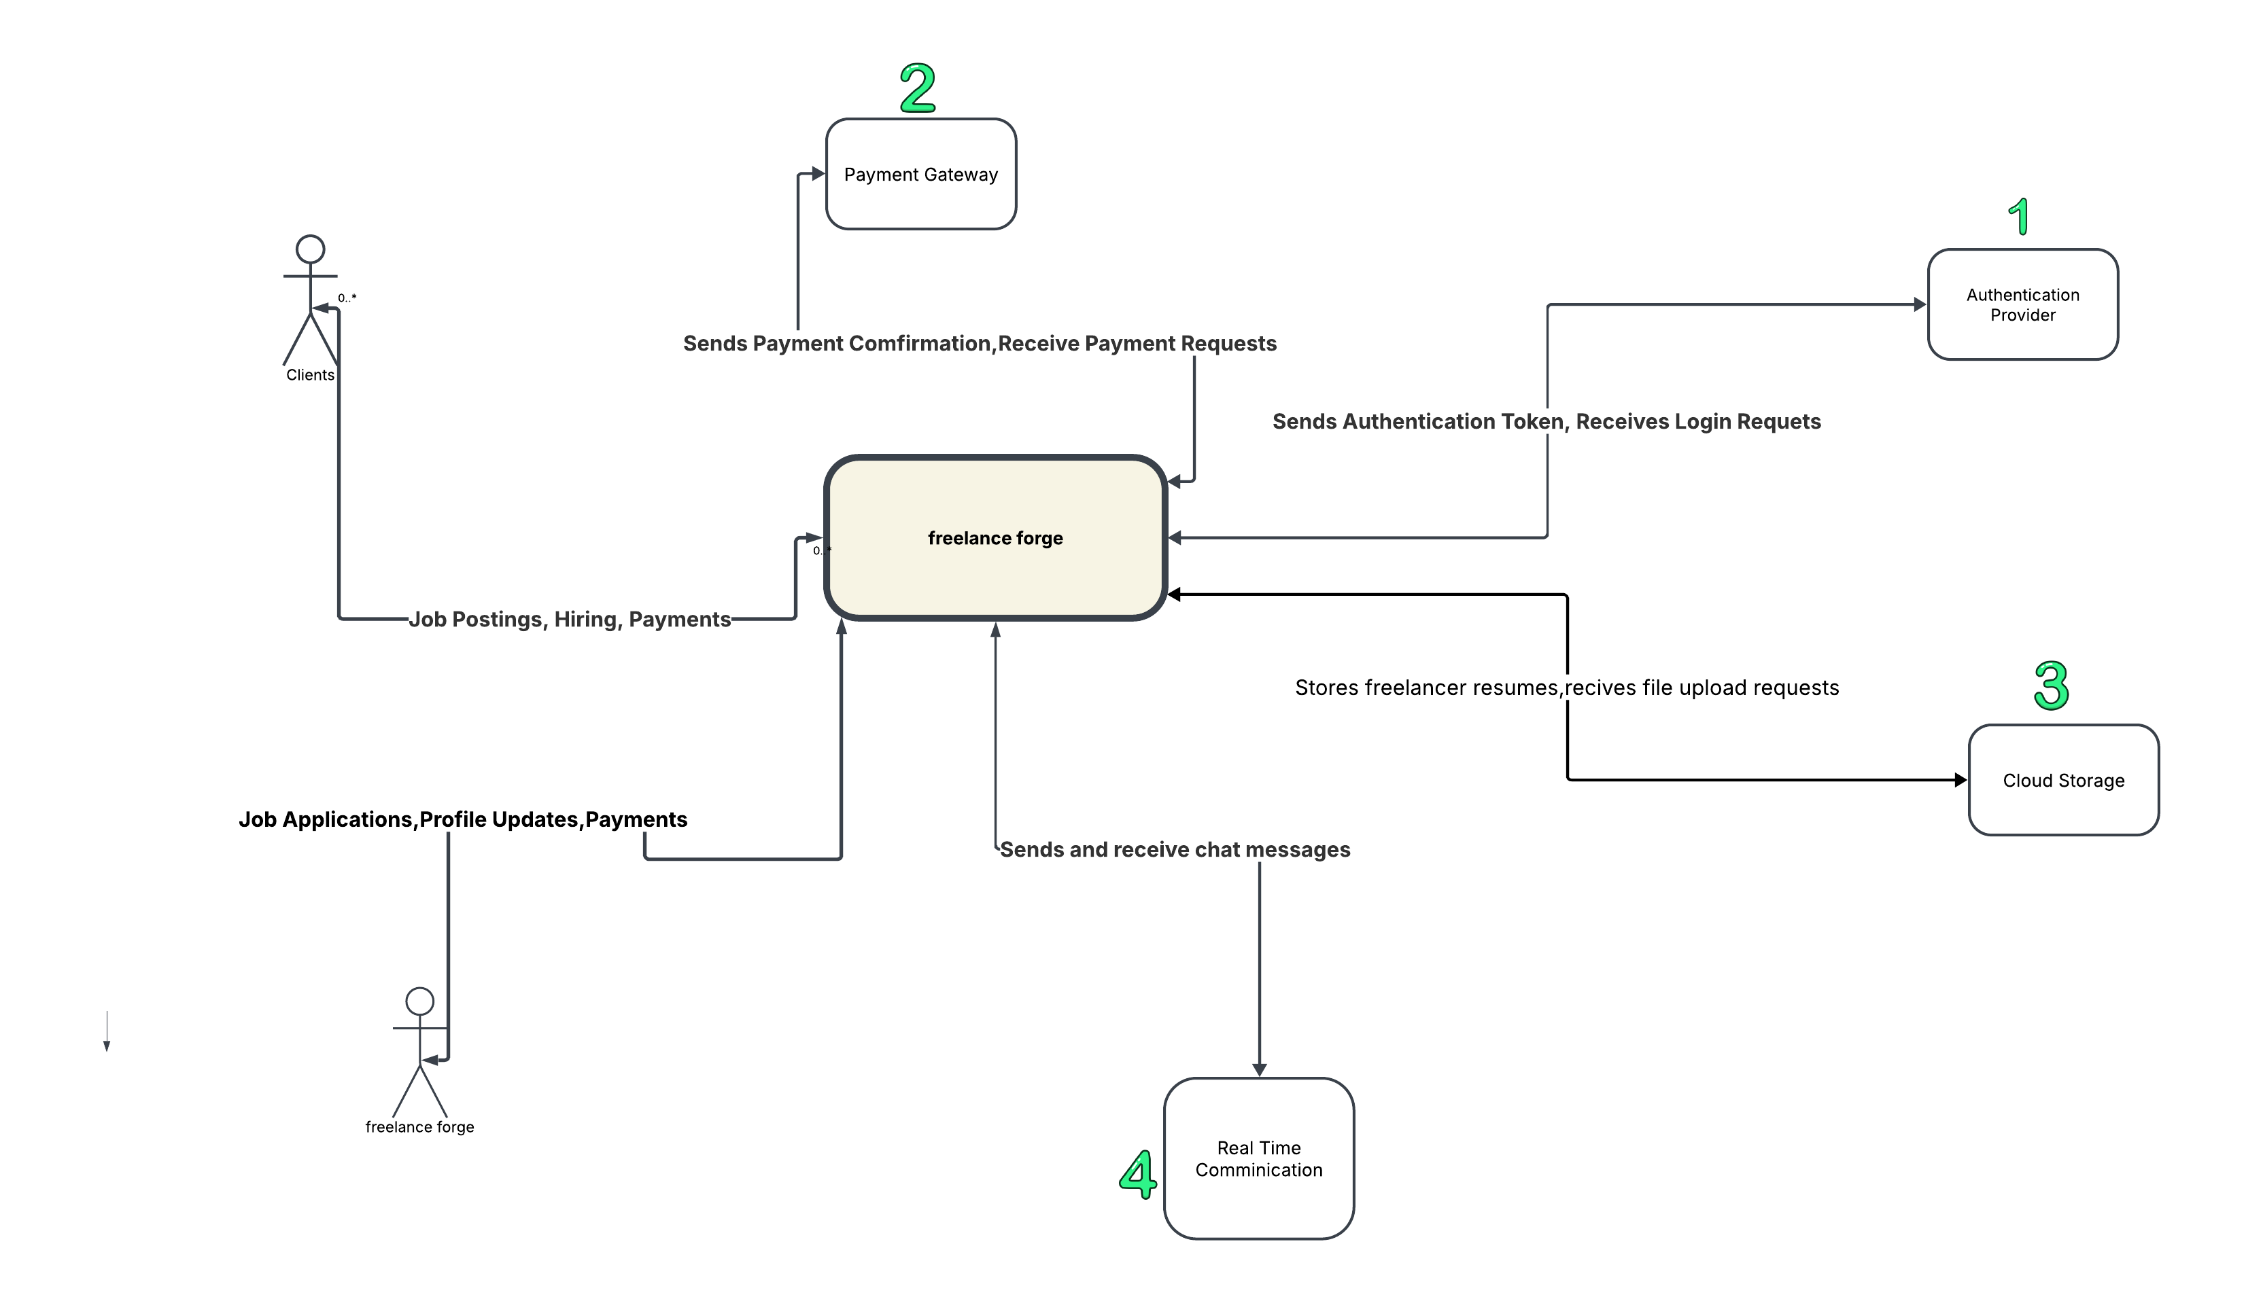
Freelance Forge:Context Diagram

Slide 2
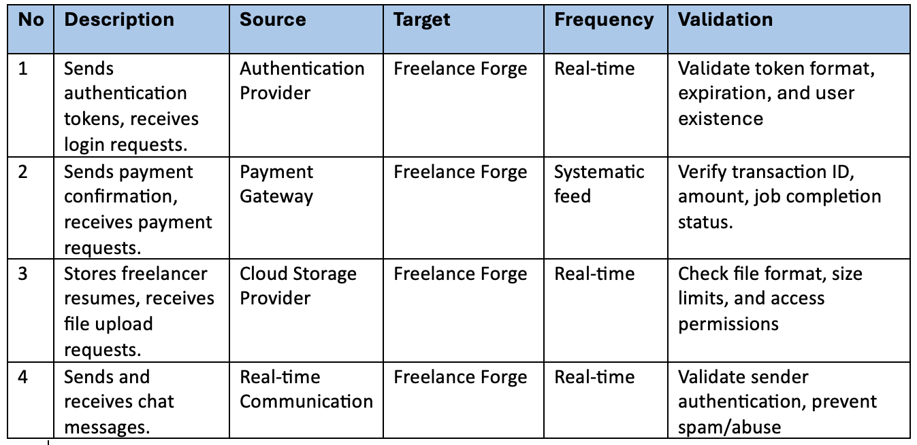
System Interface Table

